Slide 1

Spatial Data Analytics with Classical Data Mining and Machine Learning Algorithms
Yao-Yi Chiang
Computer Science and Engineering
University of Minnesota
yaoyi@umn.edu
CC-BY
Attribution

Slide 2
Mining Public Datasets for Modeling Intra-City PM_{2.5} Concentrations at a Fine Spatial Resolution
A motivating example
Lin Y., Pan F., Chiang Y.-Y., Stripelis D., Ambite J. L., Eckel S. P., and Habre R. (November 2017) Mining public datasets for modeling intra-city PM2.5 concentrations at a fine spatial resolution. ACM SIGSPATIAL.

Slide 3
Air Pollution is a Global Problem

Slide 4
Air Pollutant: PM_{2.5} and PM₁₀
PM_{2.5} : fine inhalable particles, with diameters that are generally 2.5 micrometers and smaller
United States Environmental Protection Agency

Slide 5
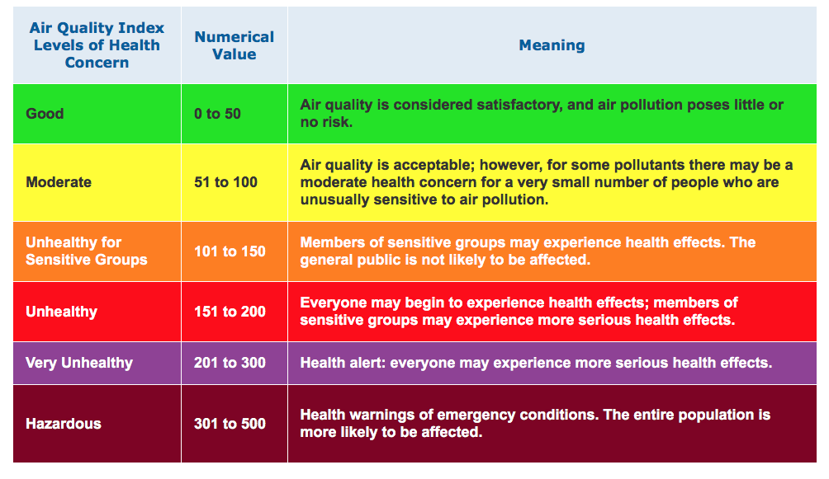
Air Quality Index
AQI: air quality index computed from a piecewise linear function of the pollutant concentration (e.g., 12.0 micrograms per cubic meter is 50 AQI for PM2.5).

Slide 6
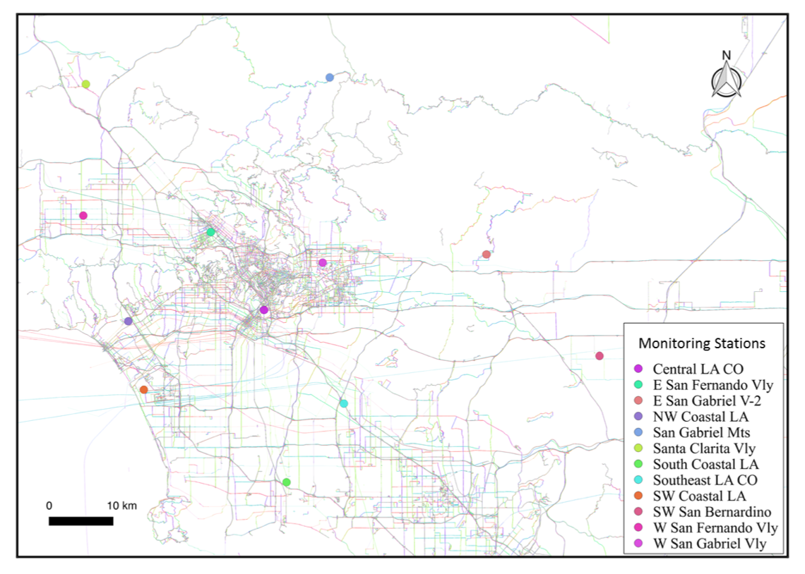
Limited Air Quality Observations
Monitoring stations are usually sparse – 12 stations for PM_{2.5} in Los Angeles
Central LA

Slide 7
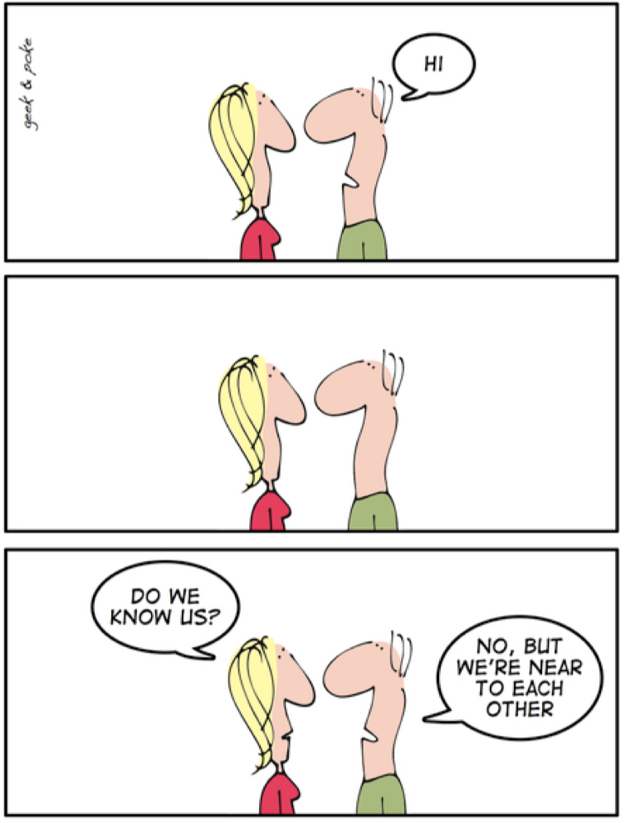
Nearby locations would have similar air quality
Tobler's 1st law of geography:
Spatial interpolation? IDW?
“all things are related, but nearby things are more related than distant things” Tobler – 1970
Vandecasteele & Devillers, Improving volunteered geographic data quality using semantic similarity measurements

Slide 8
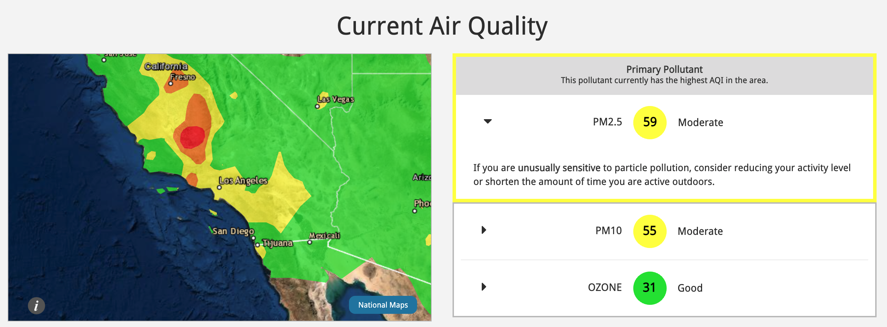
Typical Air Quality Prediction Result (AirNow)
https://www.airnow.gov/?reportingArea=Central%20LA%20CO&stateCode=CA

Slide 9
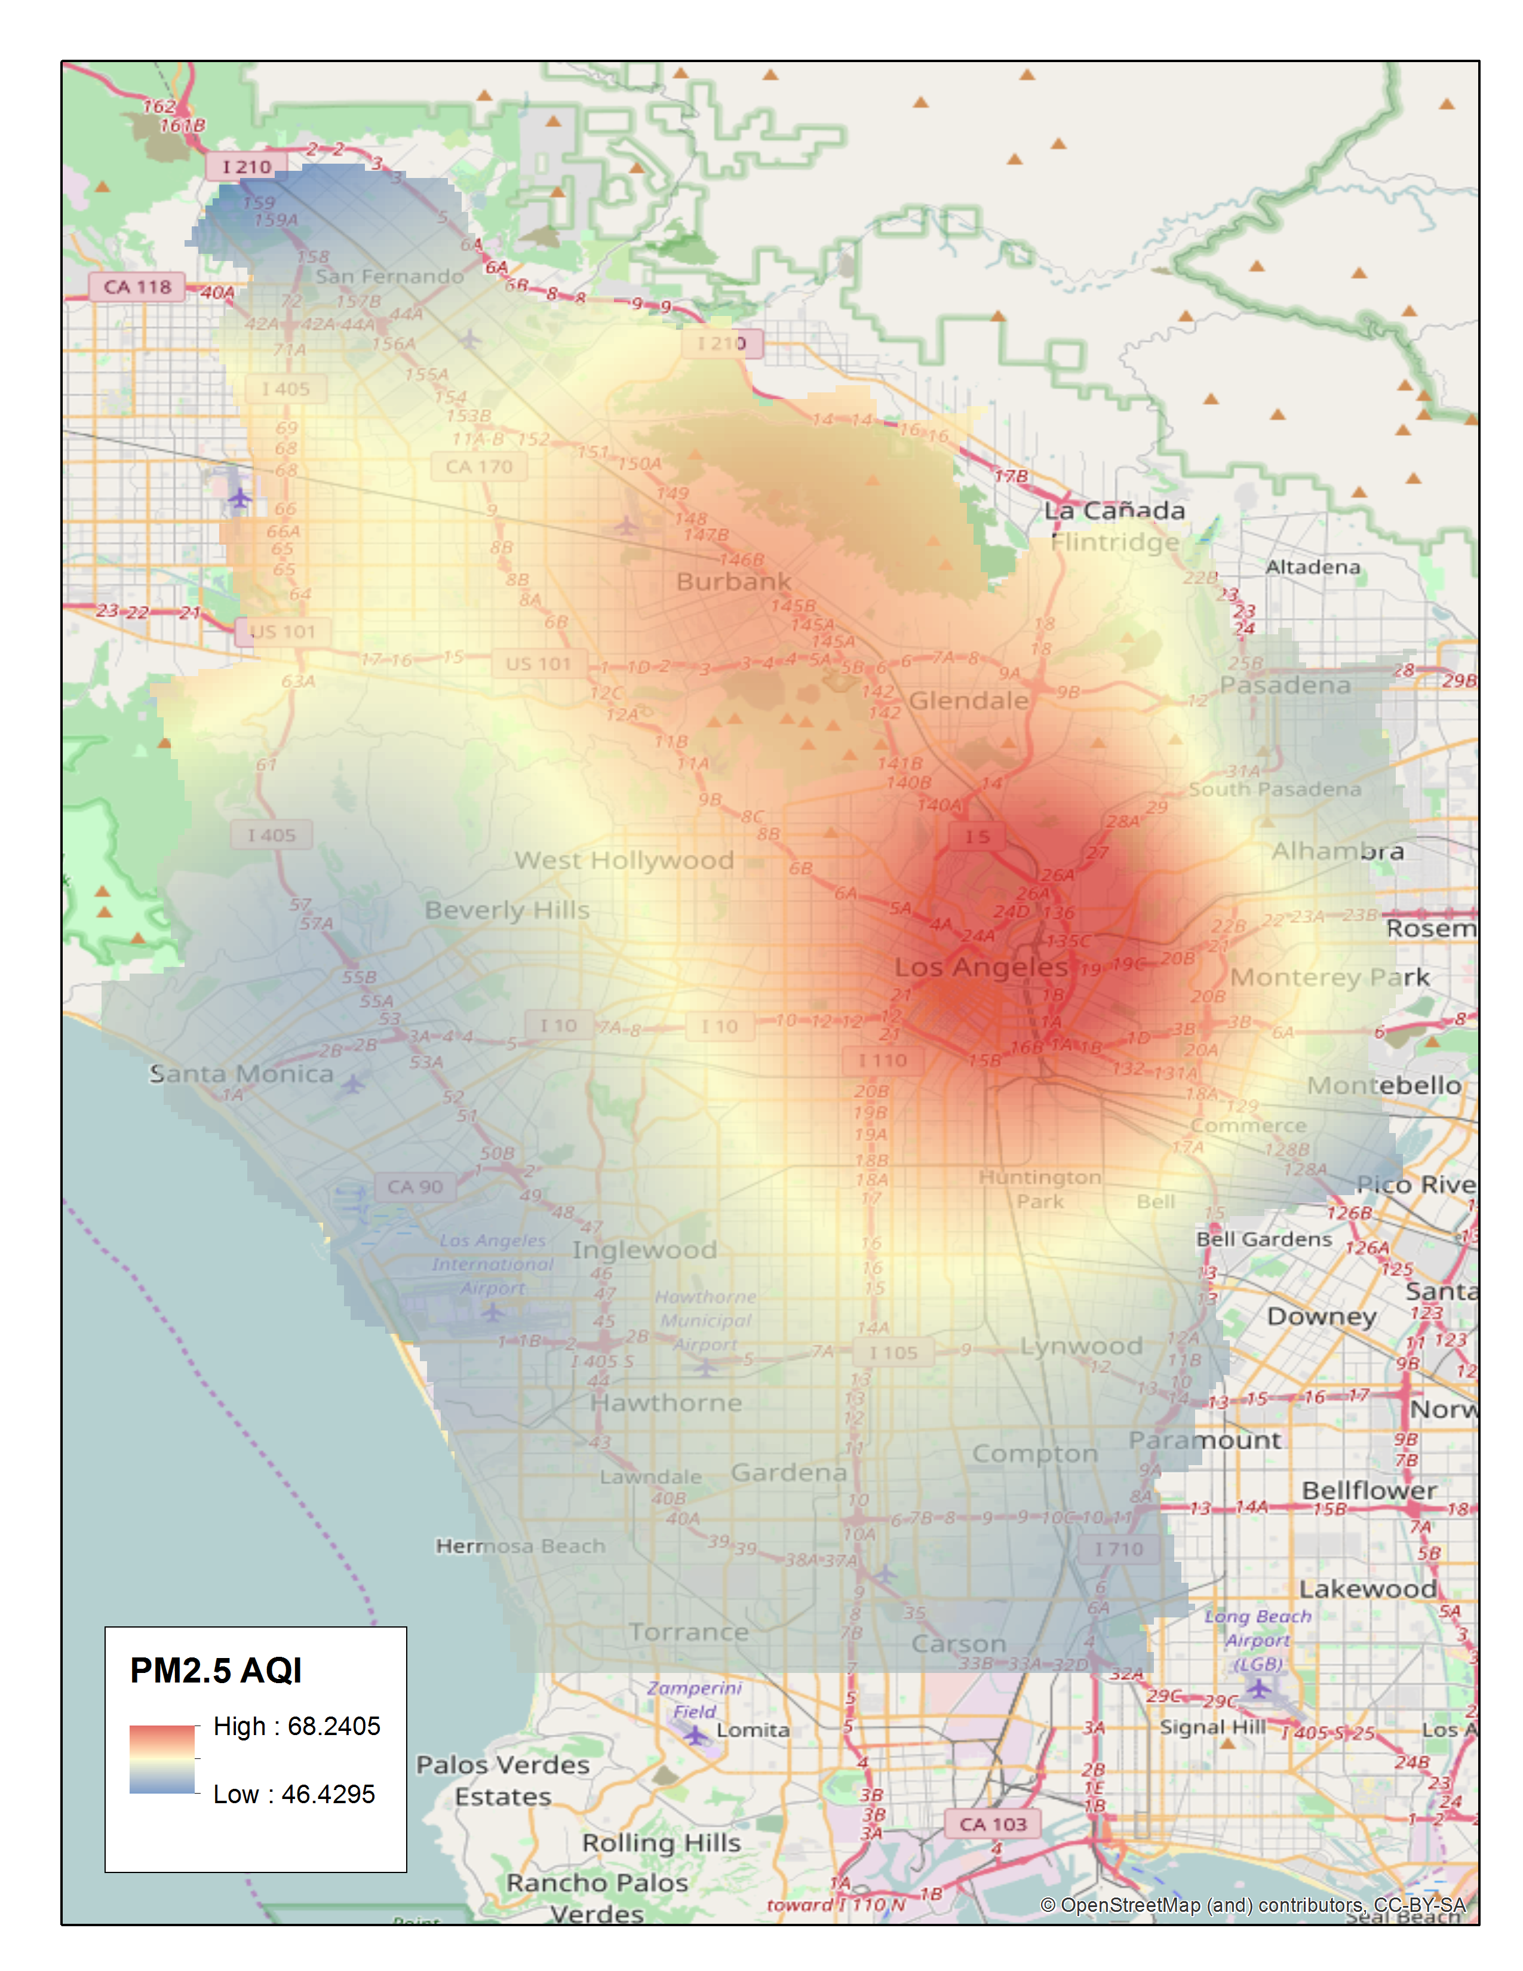
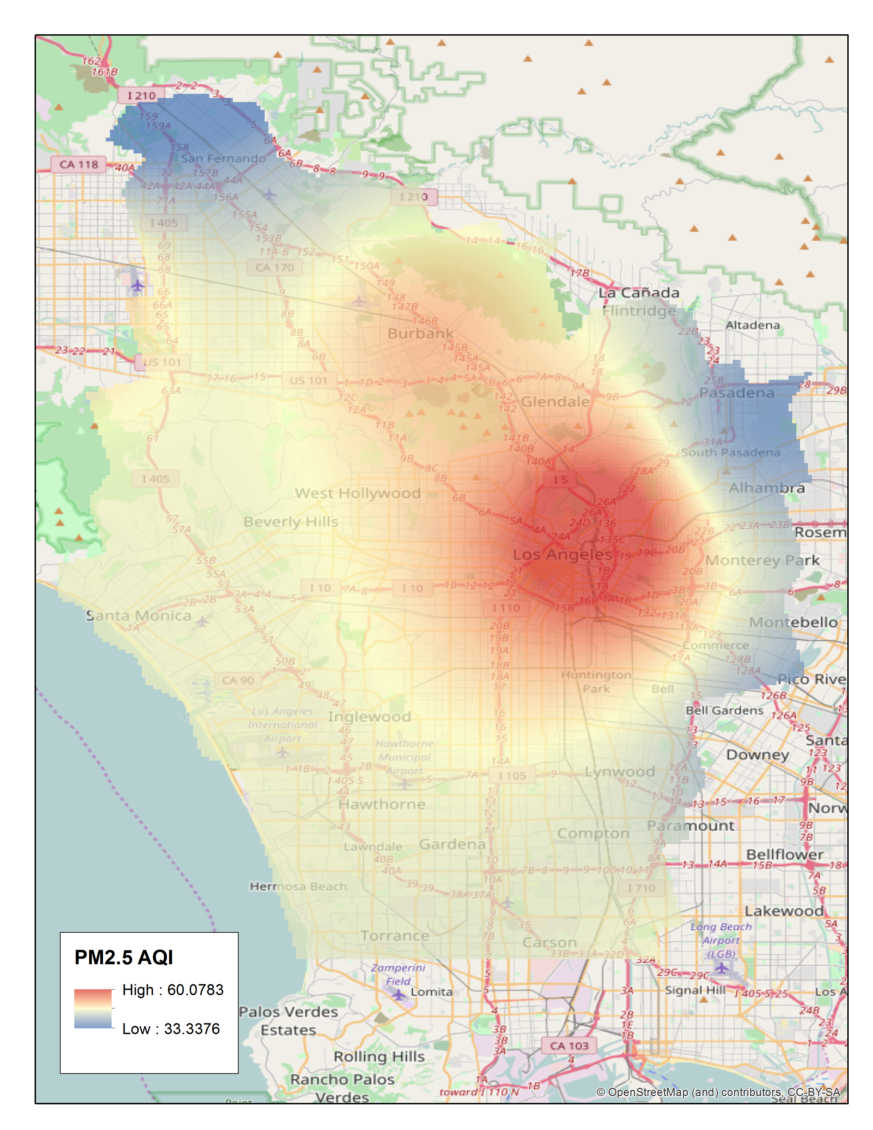
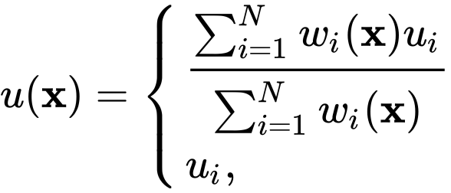
Inverse Distance Weighting
Why are the results so smooth over space?
Recall IDW:
Dec 2016
Jan 2017

Slide 10
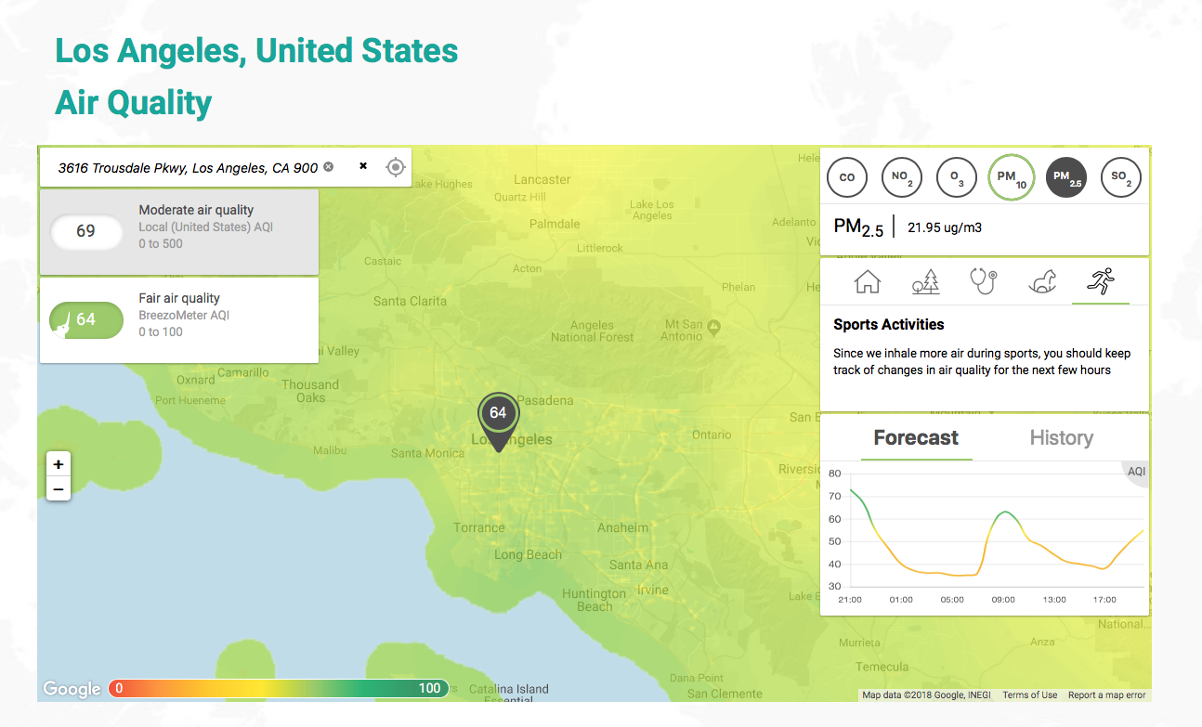
Machine Learning Methods
Some prediction variations in space, e.g., the road network is obvious
“Powered by proprietary algorithms,
strict QA & machine learning.”

Slide 11

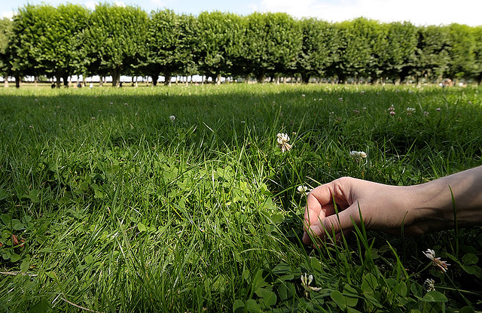
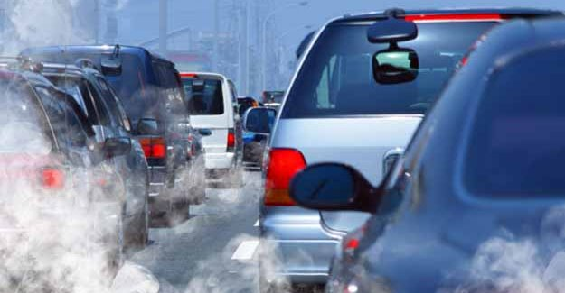
Existing Work for Air Quality Modeling
The built environment has a strong impact on air quality but how?
?

Slide 12


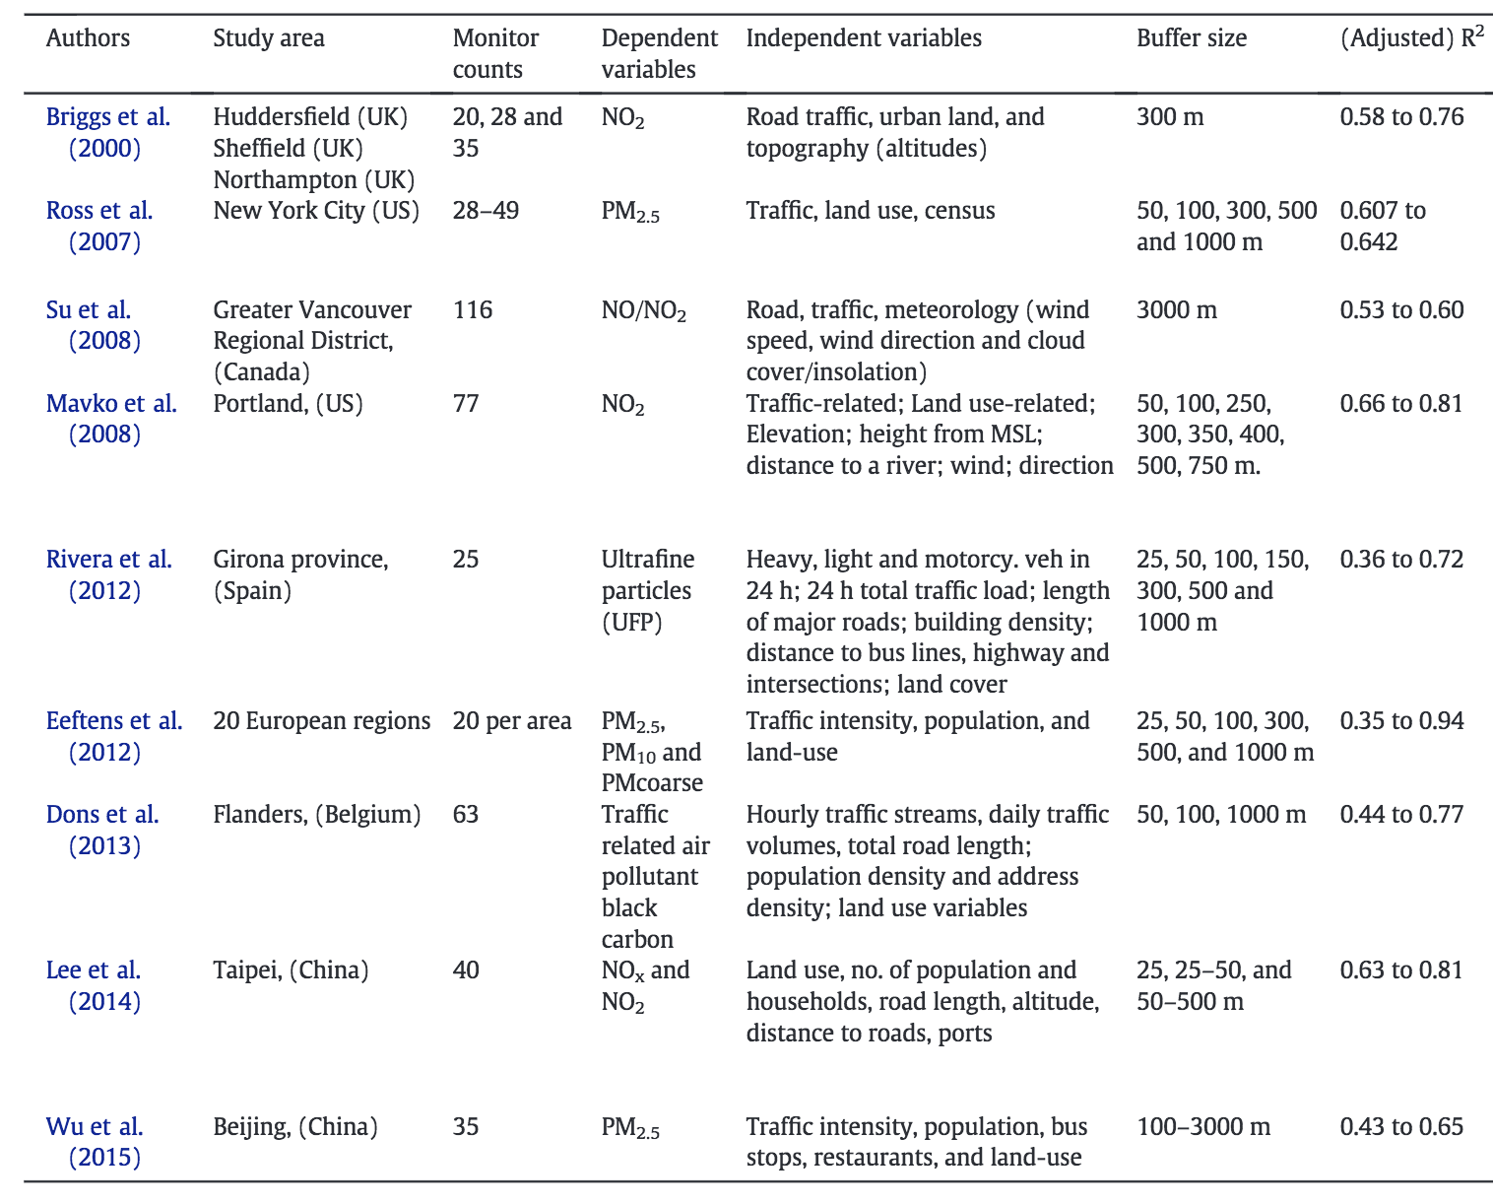
Land-use Regression Models (LUR)
Expert-selected &
Area-specific
e.g., PM_{2.5} concentrations is high near 500 meters of highways in Los Angeles
Taiwan
Source: Liu et al., 2016

Slide 13
LUR Limitations
Experts are expensive
Do not scale well for predictions at various spatial and temporal resolutions
Sometimes rely heavily on datasets that are not easy to obtain
e.g., traffic
Can we do better?
Source: Liu et al., 2016

Slide 14
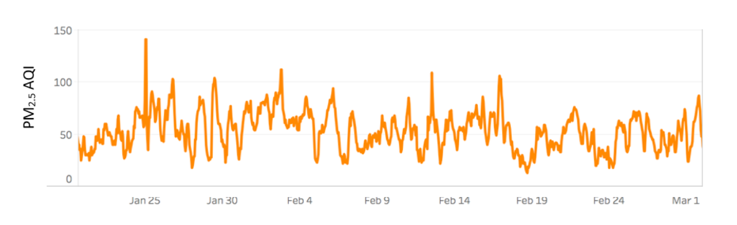
JonSnow: Data-Driven Air Quality Prediction at Fine-Spatial Scale
Problem
Given some sensors and their locations, predicting air quality for locations that do not have a sensor
Hypothesis
Similar environments should have a similar air quality

Slide 15




Data Collection
PRISMS-DSCIC – A scalable data integration and analysis architecture
Analytics
General Data Processing
Integration and Storage
Streaming
Data Sources / Sensors

Slide 16
Data Sources – I
AQS (Air Quality System) Data
Hourly PM_{2.5} AQI from 12 monitoring stations in the Los Angeles Area from 2016-10-30 00:00:00 to 2017-08-31 23:00:00
San Gabriel Mts
Monitoring Station | Timestamp | PM_{2.5} AQI
San Gabriel Mts | 2017-03-04 12:00:00 | 44
San Gabriel Mts | 2017-03-04 13:00:00 | 54
Central LA | 2017-03-04 12:00:00 | 60
Central LA | 2017-03-04 13:00:00 | 68
Central LA
Sample data

Slide 17
Data Sources – II
Geographic Features - OpenStreetMap (OSM)
Land uses (67,972 polygons), Roads (544,142 lines), Water areas (11,207 polygons), Buildings (2,971,349 points), Aeroways (962 lines), etc.
Each geographic category contains various feature subtypes
e.g., subtypes for “Buildings”: commercial, apartment, house, industrial, school, etc.

Slide 18
Recall: JonSnow: Data-Driven Air Quality Prediction at Fine-Spatial Scale
Problem
Given some sensors and their locations, predicting air quality for locations that do not have a sensor
Hypothesis
Similar environments should have a similar air quality

Slide 19
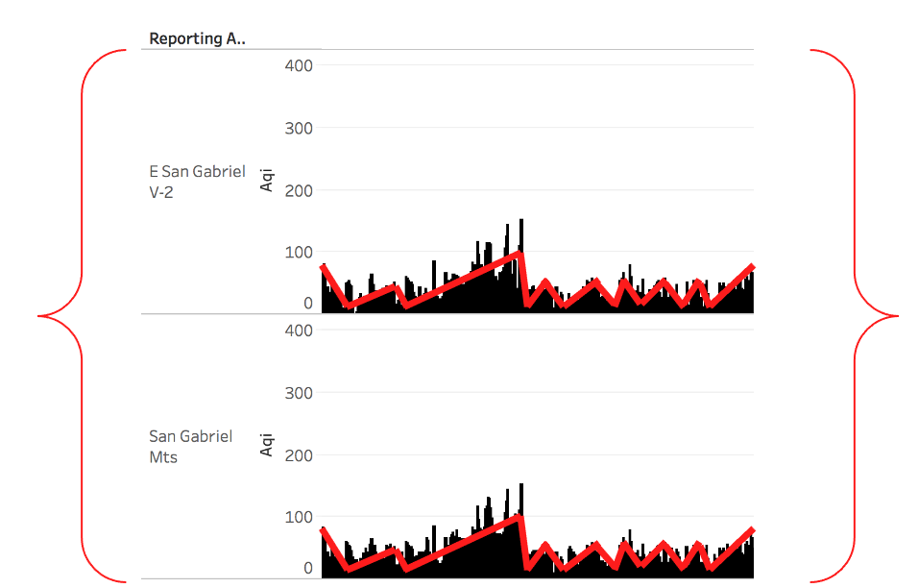
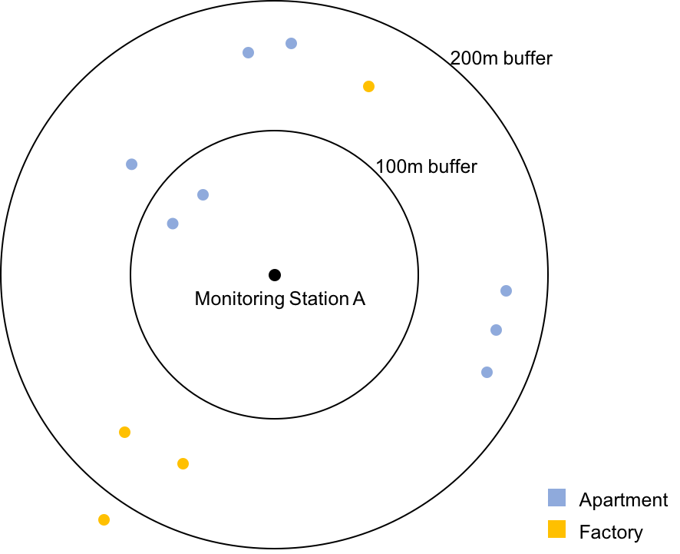
Approach Overview
Similar environments should have a similar air quality
How to quantify “similar air quality”
Clustering of air quality measurements
K-Means, hierarchical clustering, dimension reduction
How to quantify ”similar environments”
Train an interpretable machine learning model using geographical context to predict whether two locations would have “similar air quality”
Random Forest
Pedestrian
100m
Motorway
100m
…
Factory
200m
Apartment
200m
Monitoring Station 0
0.1
5.28
2
0.3
Pedestrian
100m
Motorway
100m
Apartment
200m
Factory
200m
…
Monitoring Station 1
0.0
3.27
0.041
0.432

Slide 20
Required Technologies
Clustering
K-Means, Hierarchical Clustering
Dimension Reduction
SVD (Singular Value Decomposition)
Interpretable Machine Learning Method
Random Forest

Slide 21
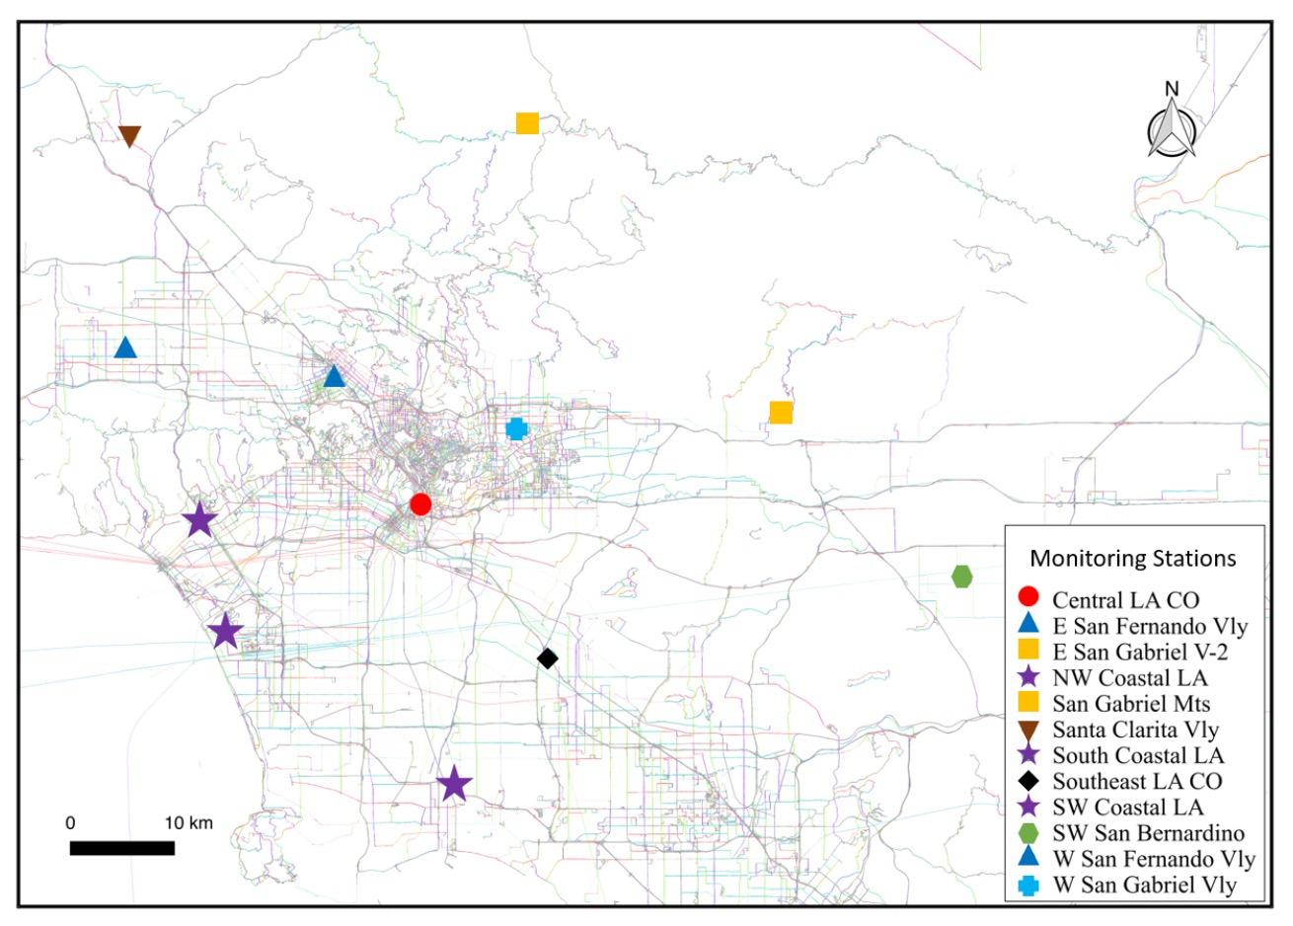
Step 1. Grouping Stations based on their PM_{2.5} AQIs
To identify the monitoring stations that have similar temporal pattern on PM_{2.5} AQIs
These monitoring stations should have a similar environment.
Notes:
Feature selection – we don’t know which variable in the built environment affect PM2.5 and from what distance

Slide 22
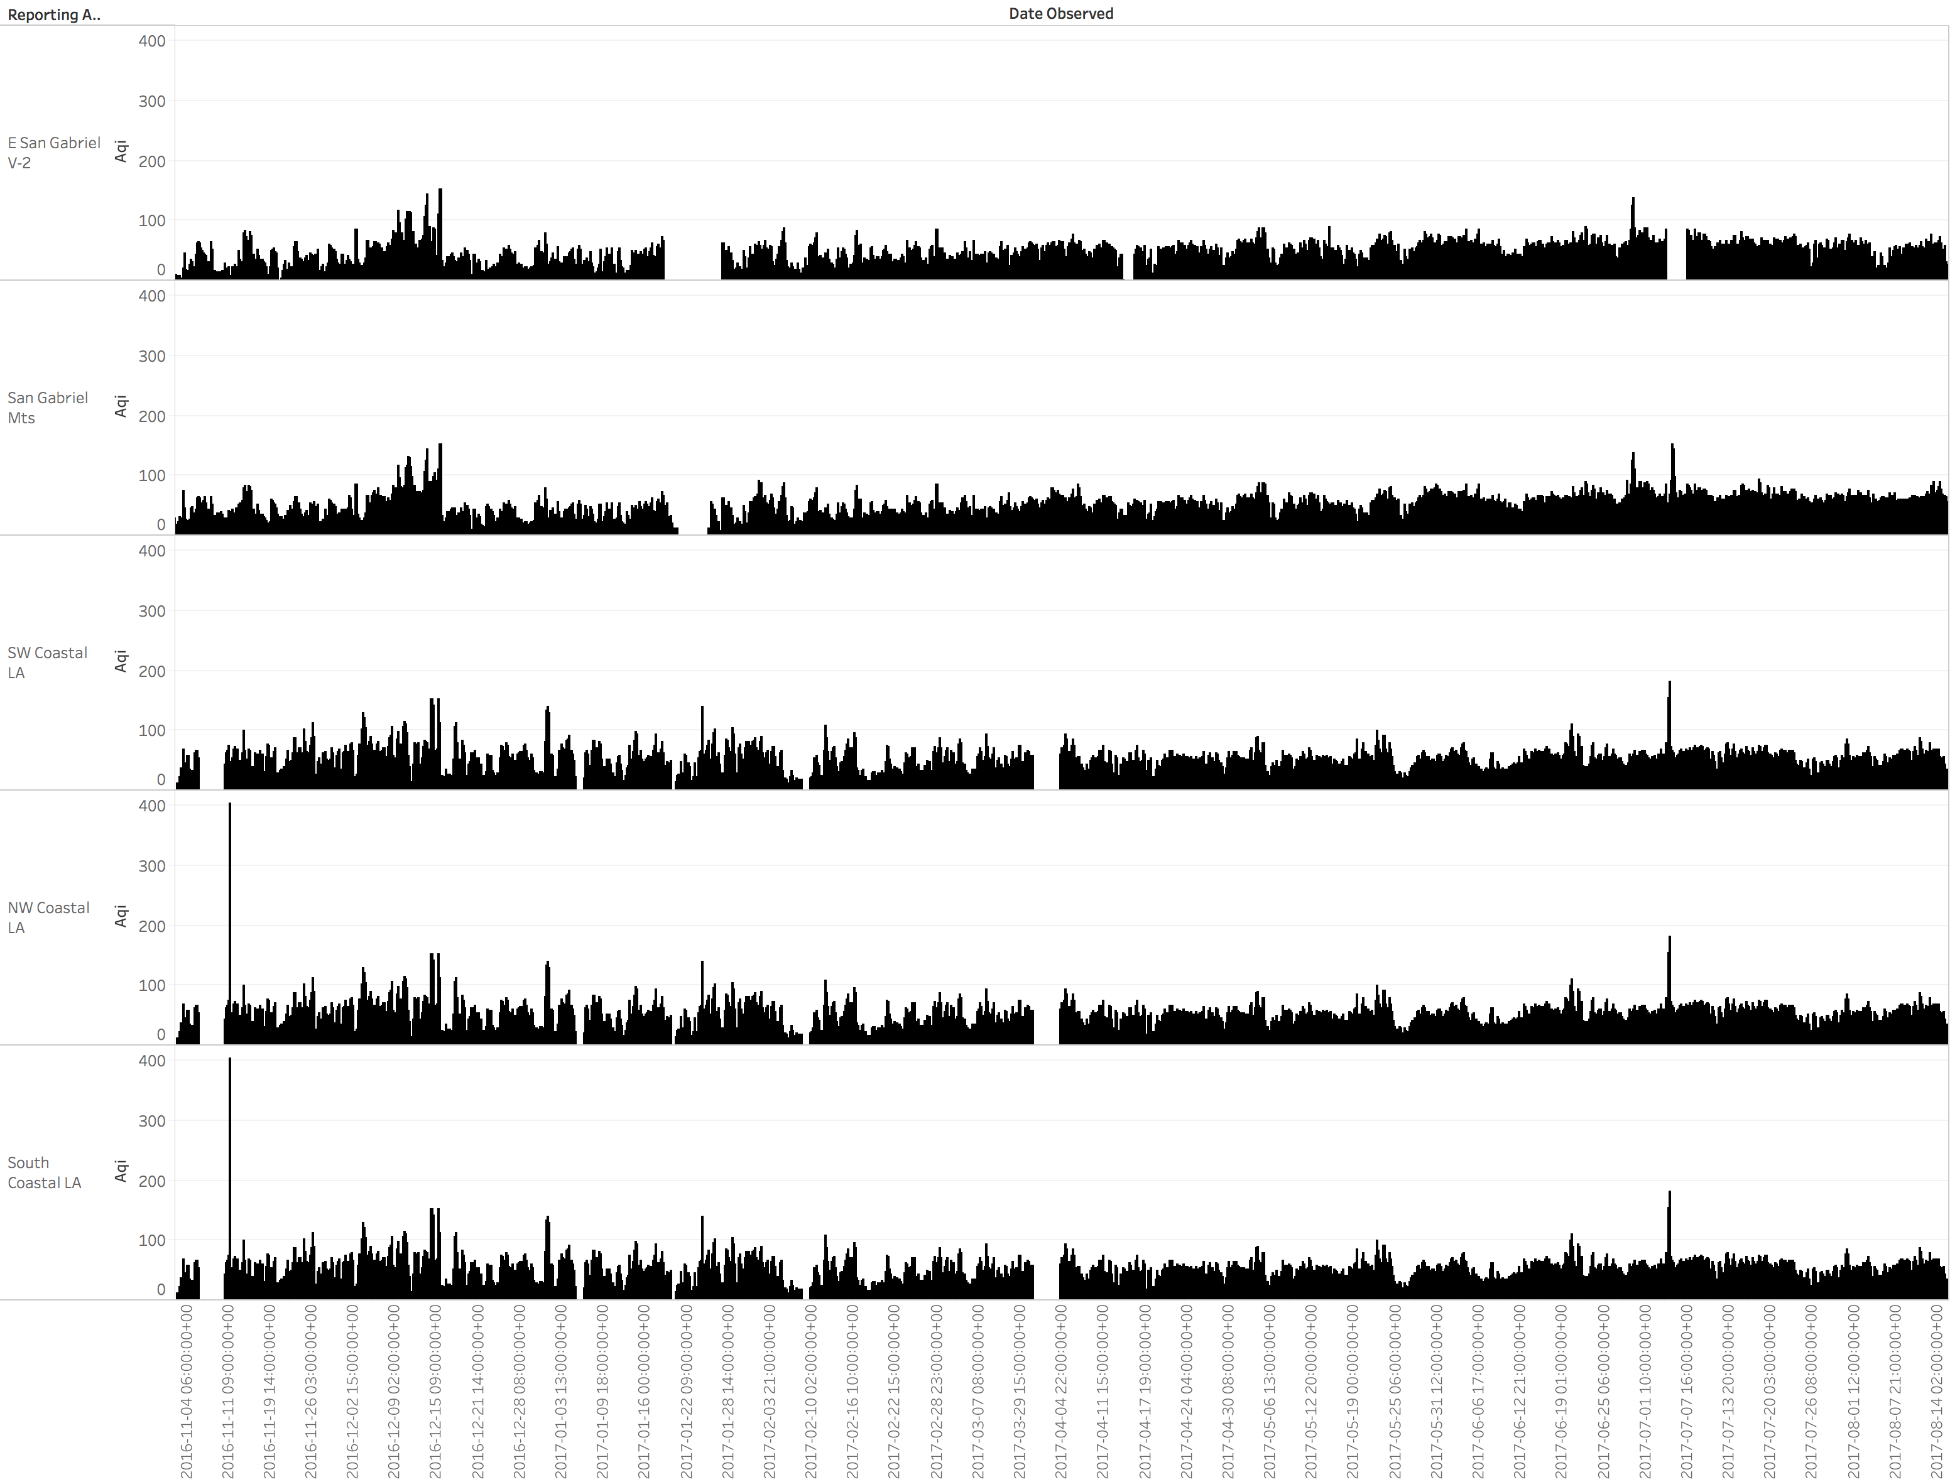
Similar Temporal Pattern

Slide 23
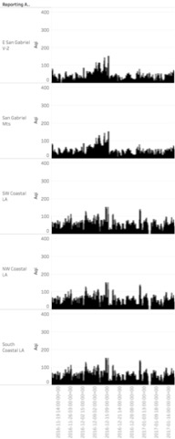
K-means Clustering
Input: time-series observations at each station
Output: clusters of stations having a similar temporal pattern

Slide 24
K-means Clustering
Recall: Hypothesis
Similar environments should have a similar air quality
Stations in the same cluster have a similar temporal pattern
How to quantify “similar environment”
what specific geographic feature types (e.g., primary roads, industrial areas, parks)
from what distance have the most impact on the clustering result?
Output: clusters of stations having a similar temporal pattern

Slide 25
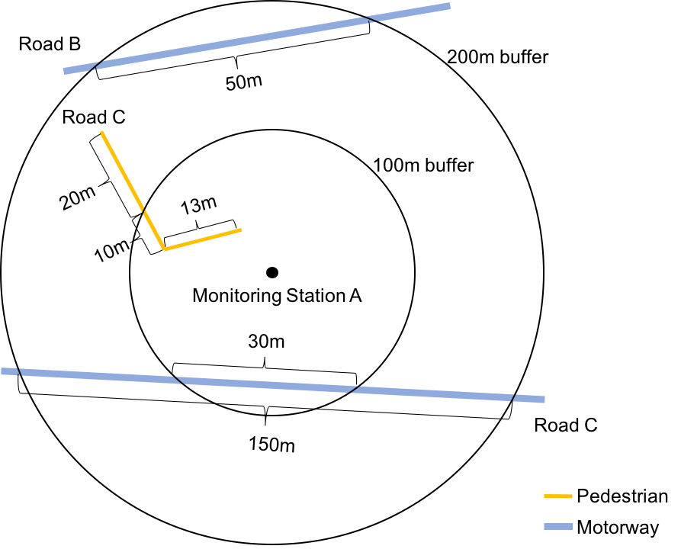
Step 2. Generating Geographic Abstraction
Length of line features
e.g., Roads, Aeroways
Example Roads
 | 100m | 200m
Pedestrian | 23 | 43
Motorway | 30 | 200
[23, 30, 43, 200]

Slide 26
Step 2. Generating Geographic Abstraction
Count of point features
e.g., Buildings
Example Buildings
 | 100m | 200m
Apartment | 2 | 8
Factory | 0 | 3
[2, 0, 8, 3]

Slide 27
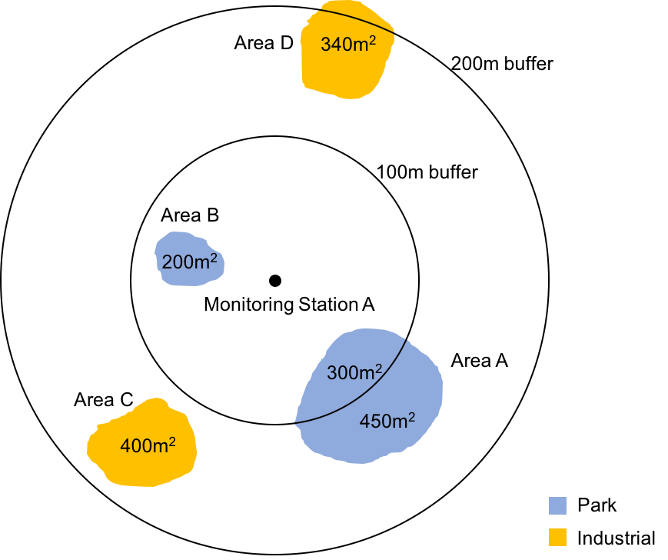
Step 2. Generating Geographic Abstraction
Area of polygon features
e.g., Land uses, Water areas
Example Land uses
 | 100m | 200m
Park | 500 | 950
Industrial | 0 | 740
[500, 0, 950, 740]

Slide 28
Step 2. Generating Geographic Abstraction
Generating a large vector for each monitoring station
In practice, we creates buffers from 100 meters to 3,000 meters with an interval of 100 meters
3,500+ components in a vector
Pedestrian
100m
Motorway
100m
Pedestrian
200m
Motorway
200m
Park
100m
Industrial
100m
Monitoring Station X
23
30
43
200
500
0
Park
200m
Industrial
200m
Apartment
100m
Factory
100m
Apartment
200m
Factory
200m
Distance to Ocean
950
740
2
0
8
3
4000

Slide 29
How to quantify “similar environment”
?
Geographic abstraction
Clustering result

Slide 30
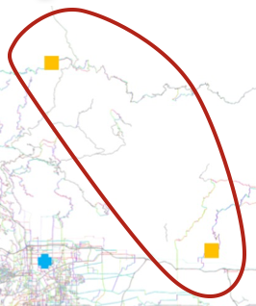
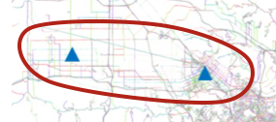
Step 3. Computing Feature Importance
Training a random forest model to
predict cluster label using the geographic context
each feature component represents a geographic feature type within certain distance
quantify the impact of each feature component
Temporal pattern cluster
Pedestrian
100m
Motorway
100m
Apartment
200m
Factory
200m
…
Monitoring Station 1
23
30
2
3
Cluster 1
Pedestrian
100m
Motorway
100m
Apartment
200m
Factory
200m
…
Monitoring Station 2
10
25
1
3
Cluster 1
Pedestrian
100m
Motorway
100m
Apartment
200m
Factory
200m
…
Monitoring Station 3
56
5
7
0
Cluster 2
Pedestrian
100m
Motorway
100m
Apartment
200m
Factory
200m
…
Monitoring Station 4
67
10
8
0
Cluster 2

Slide 31
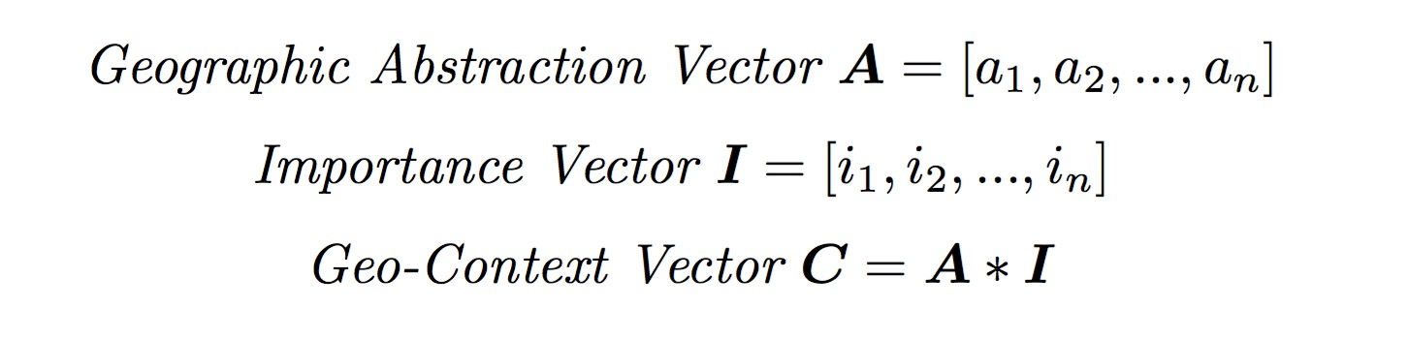
Step 3. Generating Geo-context
Multiplying each geographic abstraction value by its feature importance to generate geo-context
Example of Importance
Geo-feature | Importance
Pedestrian 100m | 0.000
Motorway 100m | 0.109
… | …
Apartment 200m | 0.041
Factory 200m | 0.144
… | …
Total | 1.0
Pedestrian
100m
Motorway
100m
…
Factory
200m
Apartment
200m
Monitoring Station 1
(Geographic Abstraction)
23
30
2
3
Pedestrian
100m
Motorway
100m
Apartment
200m
Factory
200m
…
Monitoring Station 1
(Geo-context)
0.0
3.27
0.041
0.432

Slide 32
Step 3. Geo-context
Geo-context is an updated vector from geo-abstract for describing
how each feature type within a certain distance (a feature component) in Geographic Abstraction affects the Temporal Pattern (PM_{2.5} AQI)
Reward important (relevant) features and penalize others
Pedestrian
100m
Motorway
100m
…
Factory
200m
Apartment
200m
Monitoring Station 1
(Geographic Abstraction)
23
30
2
3
Pedestrian
100m
Motorway
100m
Apartment
200m
Factory
200m
…
Monitoring Station 1
(Geo-context)
0.0
3.27
0.041
0.432

Slide 33
Step 4. Predicting PM_{2.5} AQI
Train a regression model to predict PM_{2.5} AQI for a target location at time T
[Geo-context, AQI] for each monitoring station at time T
Regression Model
AQI prediction of target location
[Geo-context] for target location

Slide 34
Experiments
Leave-one-out cross-validation method
Predict PM_{2.5} AQI for the removed station by using other 11 stations
Compare our approach with baseline methods
Predicting at a fine scale
Predict PM_{2.5} AQI of each point on an 1-mile-apart fishnet covering most of the Los Angeles area (604 points)
Visualize the fine-scale prediction results

Slide 35
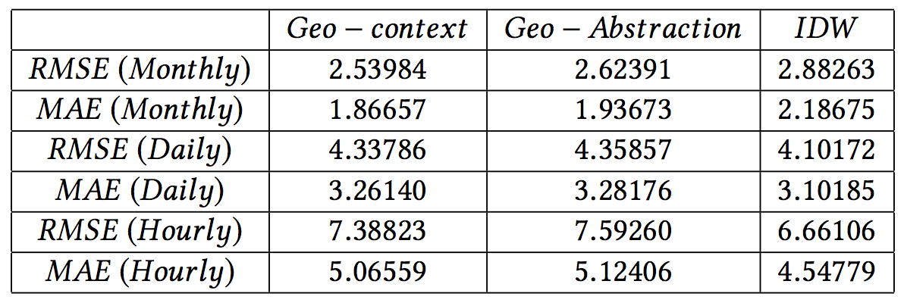
Experiment & Result – I
Leave-one-out cross-validation method
Tested with three methods on three temporal scales
Geo-context, Geo-abstraction, IDW (Inverse distance weighting)
Monthly (7 months), daily (233 days), and hourly (168 hours)
RMSE - root-mean-square error; MAE - mean absolute error
IDW method
All within 10% error margin; Significant different with 95% confidence (paired t-test)

Slide 36
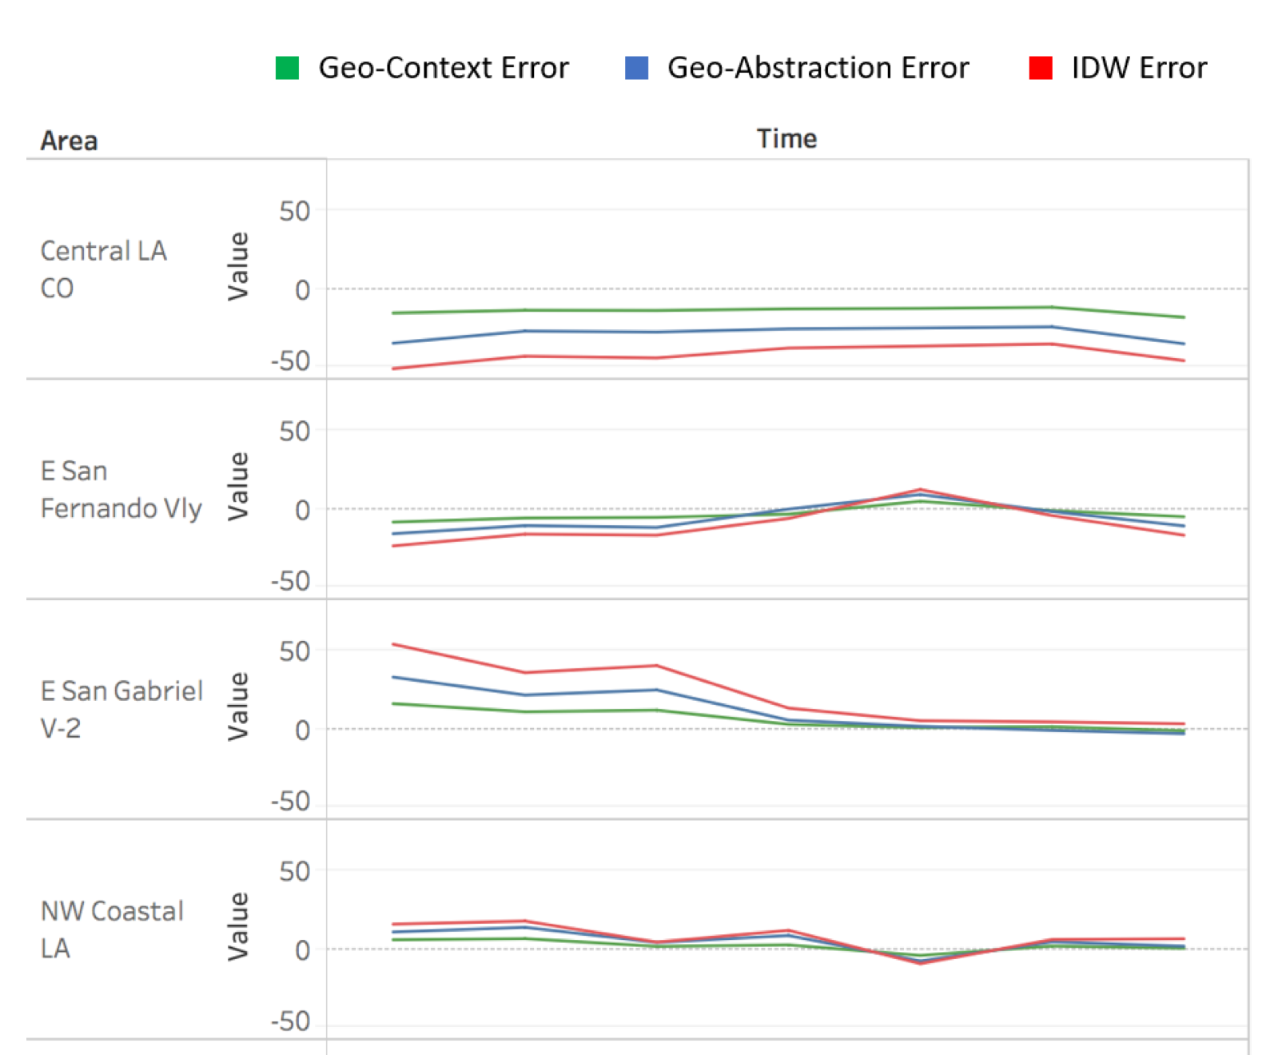
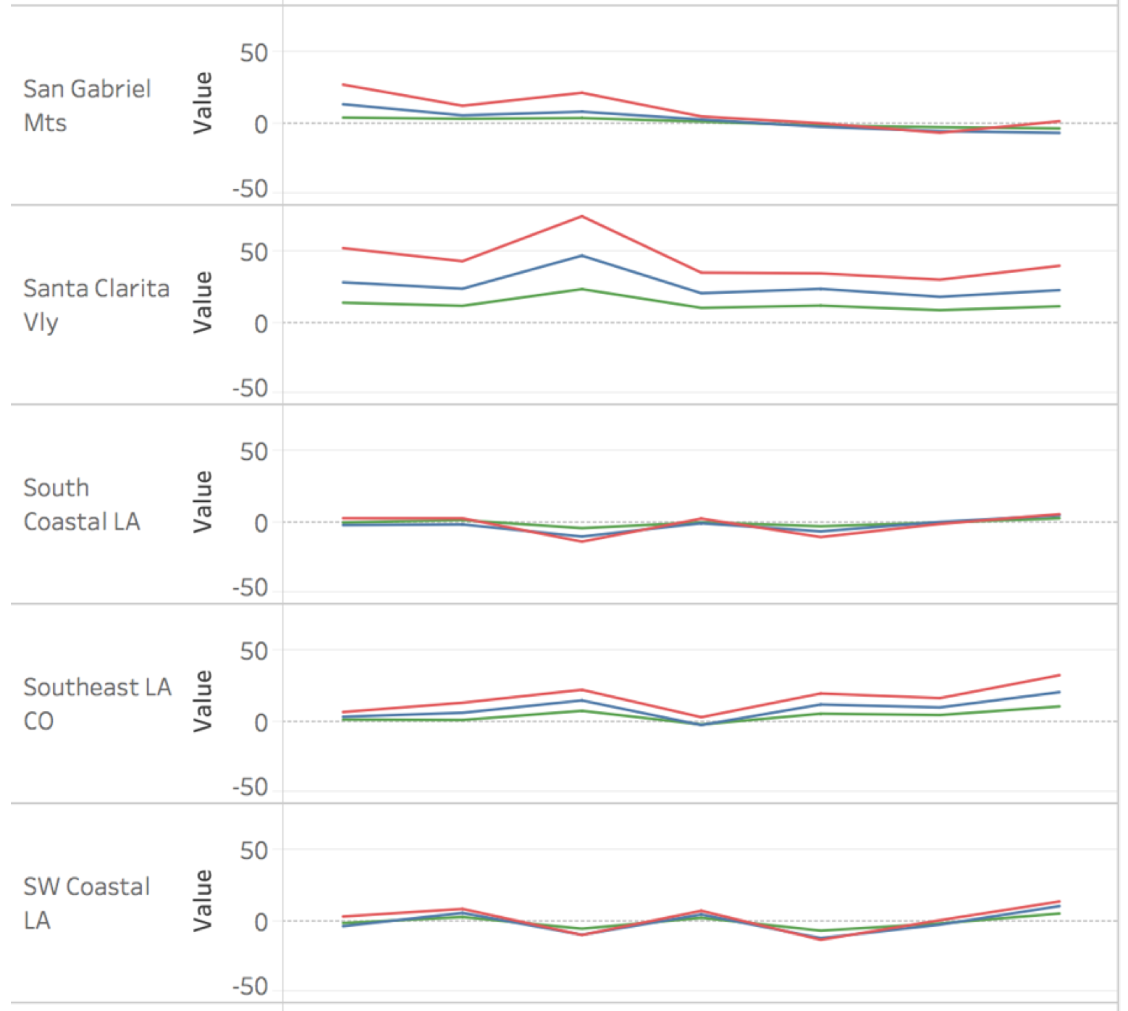
Experiment & Result – I (Cont’d)

Slide 37
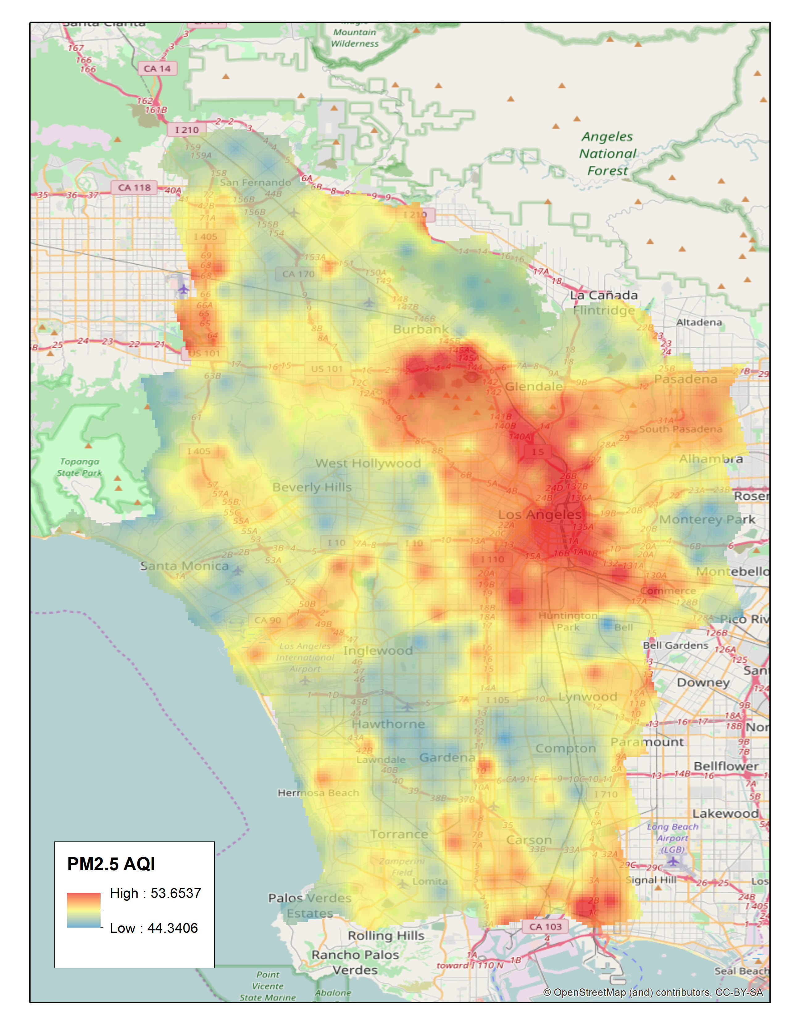
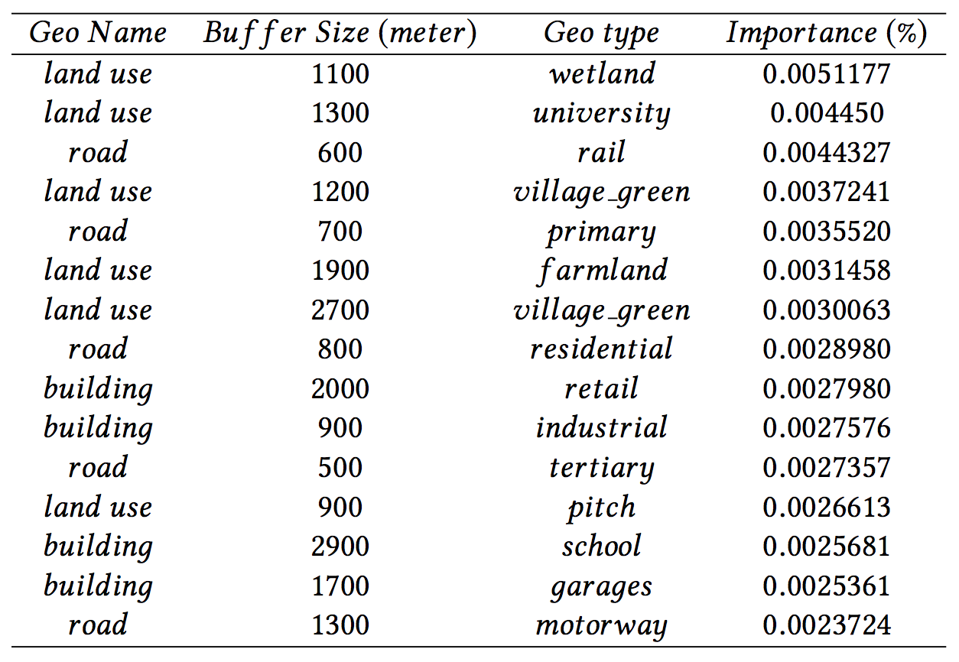
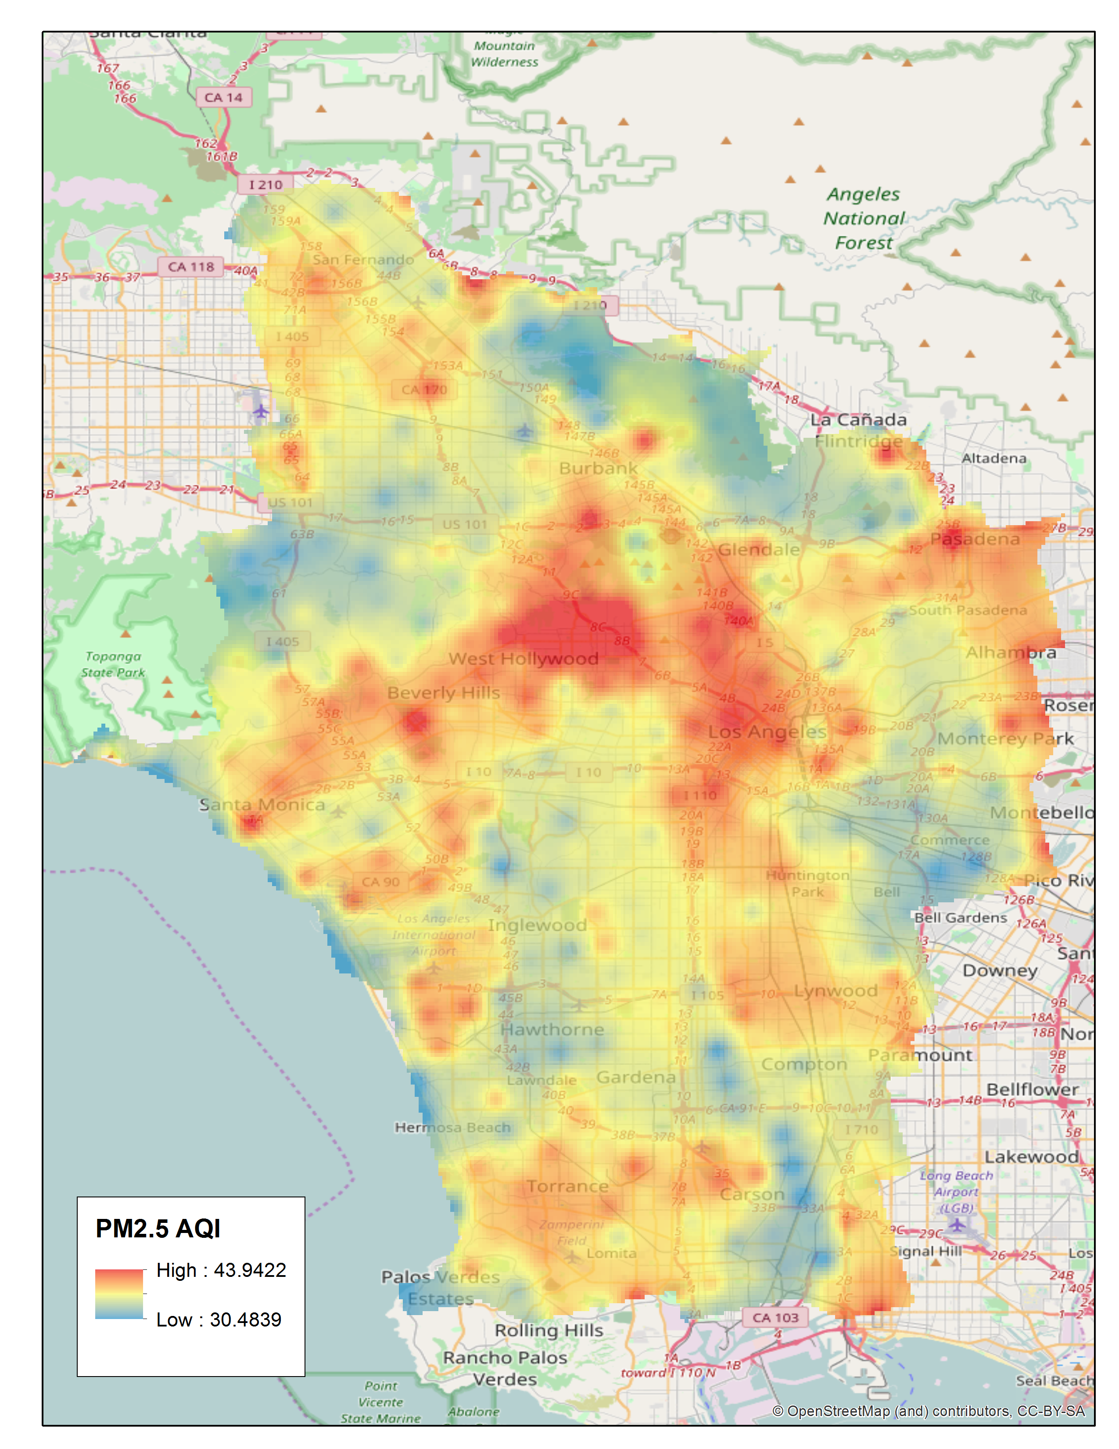
Experiment & Result – II
Geo-context
IDW
Predicting PM_{2.5} AQIs at a fine scale
Dec 2016
Dec 2016
Jan 2017
Jan 2017

Slide 38
Experiment & Result – II
Geo-context
IDW
Predicting PM_{2.5} AQIs at a fine scale
Dec 2016
Dec 2016
Jan 2017
Jan 2017

Slide 39
Experiment & Result – II
Geo-context
IDW
Predicting PM_{2.5} AQIs at a fine scale
Dec 2016
Dec 2016
Jan 2017
Jan 2017

Slide 40
Related Work
 | Limitations | Advantages of our method
Spatial interpolation methods, e.g., IDW and Kriging | Not considering neighborhood characteristic | With neighboring geographic features
 | Cannot generate a fine scale result with sparse monitoring stations | Can generate accurate result in a fine scale
Dispersion models | Require detailed data (e.g., building heights and distance between neighboring buildings) | Use easily accessible datasets (OpenStreetMap)
Land-use regression (LUR) methods (e.g., Hoek (2008)) | Rely on expert-selected predictors, including types and spatial radii | Expert-free feature selection

Slide 41
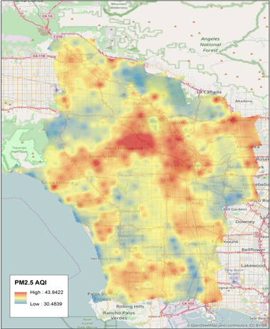
Summary
A spatial data mining approach to build an accurate model to predict PM_{2.5} concentrations at a fine scale by
Automated selection of important geographic features without using expert knowledge.

Slide 42
Additionally, Air Quality Forecasting
Goal
Build a general approach for location-dependent time-series data forecasting
Challenges:
Existing approaches do not handle spatial correlation well
e.g., Auto-Regression Integrated Moving Average (ARIMA), Kalman filtering,
Artificial Neural Network (ANN)
Our approach
We are building a Diffusion Convolutional Recurrent Neural Network for forecasting location-dependent time series data.
Continuously forecasting air quality index (AQI) in next 24 hours at a fine scale using data on the PRISMS-DSCIC
Lin, Y., Mago, N., Gao, Y., Li, Y., Chiang, Y.-Y., Shahabi, C., and Ambite, J. L. (November 2018). Exploiting Spatiotemporal Patterns for Accurate Air Quality Forecasting using Deep Learning. In Proceedings of the 26th ACM SIGSPATIAL International Conference on Advances in Geographic Information Systems, pp. 359 – 368, Seattle, WA, USA

Slide 43
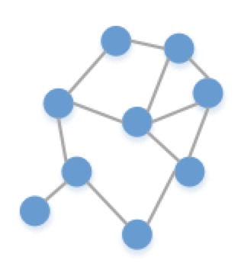
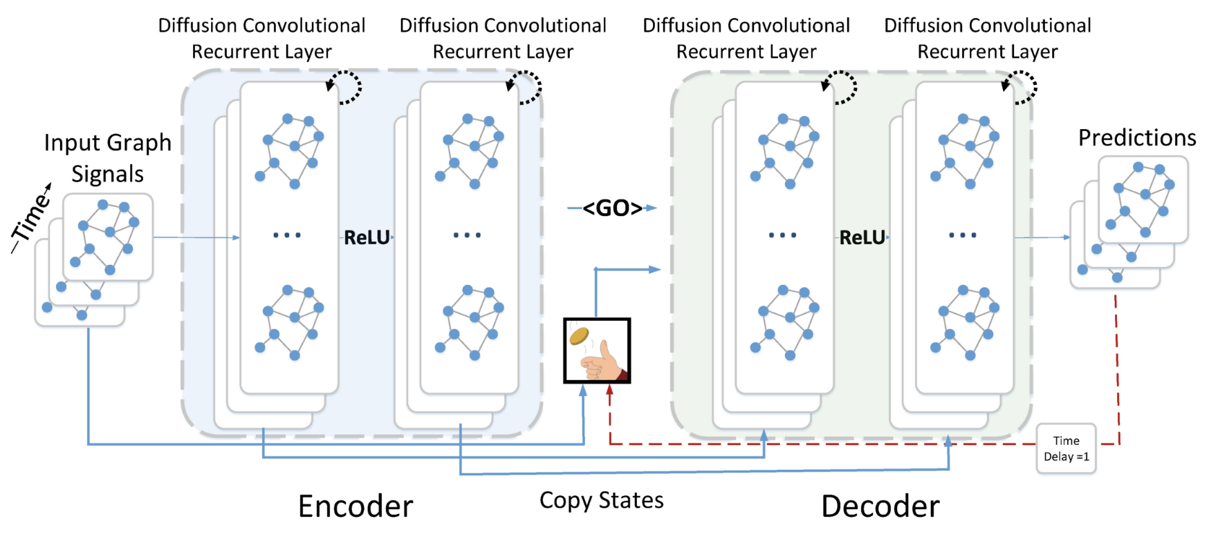
DCRNN – Diffusion Convolutional Recurrent Neural Network
Graph Construction
Each point in the graph represents the time series at the station
The link between points would be the proximity between stations (e.g., distance, geographic similarity)
Spatial Dependency Modeling
Use diffusion convolution to learn a function that maps historical graph signal to future graph signal
Temporal Dependency Modeling
Use Recurrent Neural Networks
Air quality time series
Forecasting result

Slide 44
Acknowledgements
Gil, Yolanda (Ed.) Introduction to Computational Thinking and Data Science. Available from http://www.datascience4all.org

Slide 45

These materials are released under a CC-BY License
https://creativecommons.org/licenses/by/2.0/
You are free to:
Share — copy and redistribute the material in any medium or format
Adapt — remix, transform, and build upon the material
for any purpose, even commercially.
The licensor cannot revoke these freedoms as long as you follow the license terms.
Under the following terms:
Attribution — You must give appropriate credit, provide a link to the license,
and indicate if changes were made. You may do so in any reasonable manner,
but not in any way that suggests the licensor endorses you or your use.
Artwork taken from other sources is acknowledged where it appears.
Artwork that is not acknowledged is by the author.
Please credit as: Chiang, Yao-Yi Introduction to Spatial Artificial Intelligence. Available from https://yaoyichi.github.io/spatial-ai.html
If you use an individual slide, please place the following at the bottom: “Credit: https://yaoyichi.github.io/spatial-ai.html
We welcome your feedback and contributions.
Credit: http://www.datascience4all.org/

